Slide 1
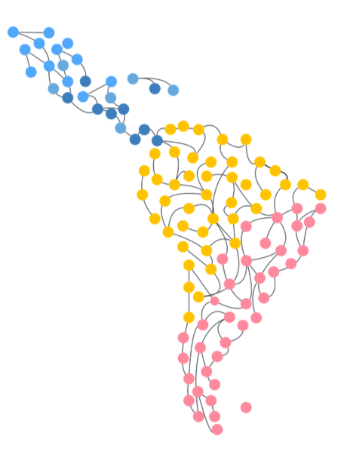

Joint characterization of phase synchronization in networks with multivariate singular spectrum analysis and vector field phase
Parallel Section | Dynamics 1 | Salón 1 | 14:15 – 15:45 | Tuesday 6
Leonardo Portes
Complex Systems Group, Dep Maths & Stats
University of Western Australia
https://orcid.org/0000-0002-4310-2942
Leandro Freitas
﻿Instituto Federal de Educação,
Ciência e Tecnologia de Minas Gerais (Brazil)
http://lattes.cnpq.br/2243352137634236
Luis Aguirre
﻿Departamento de Engenharia Eletronica
Universidade Federal de Minas Gerais (Brazil)
http://lattes.cnpq.br/6682146998710900

Slide 2
SUMARY
THE GOAL
ASSESMENT TOOLS
VECTOR FIELD PHASE (VFP) | SYNC QUALITY
VARIMAX + MULTIVARIATE SINGULAR SPECTRUM ANALYSIS
EXAMPLE

Slide 3
THE GOAL

Slide 4
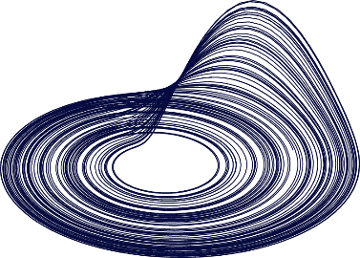

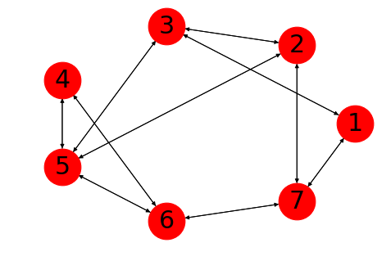
THE GOAL
If we decrease the coupling strength…
Who will desynchronize first?

Slide 5
ASSESMENT TOOLS
VECTOR FIELD PHASE (VFP) | SYNC QUALITY
VARIMAX + MULTIVARIATE SINGULAR SPECTRUM ANALYSIS

Slide 6
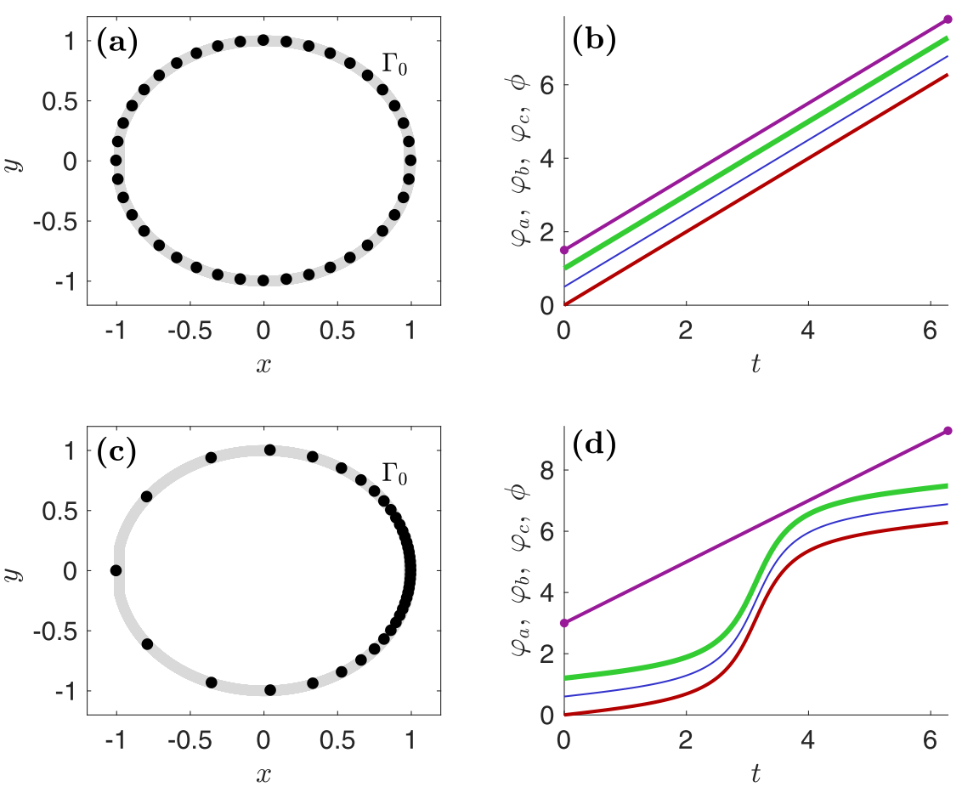
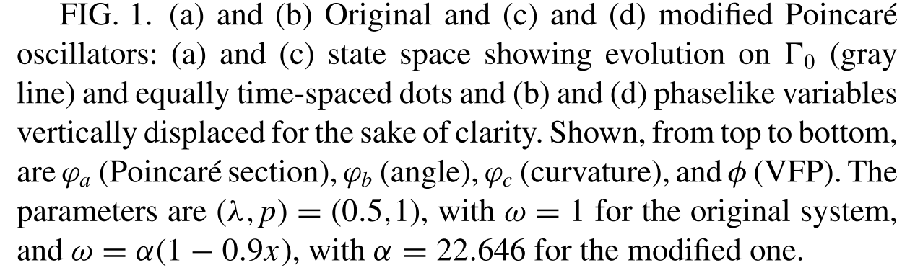
VECTOR FIELD PHASE (VFP) | SYNC QUALITY
Freitas, L., Torres, L. A. B., & Aguirre, L. A. (2018). Phase definition to assess synchronization quality of nonlinear oscillators. Physical Review E, 97(5), 052202.

Slide 7
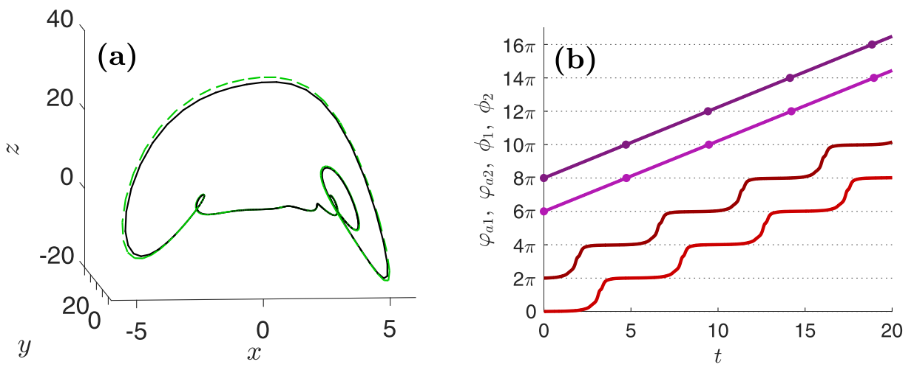
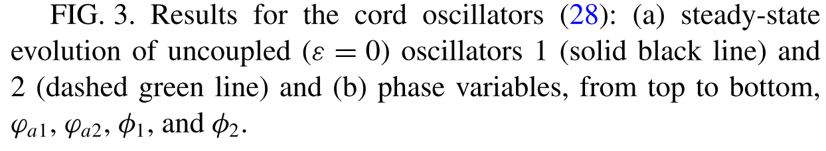
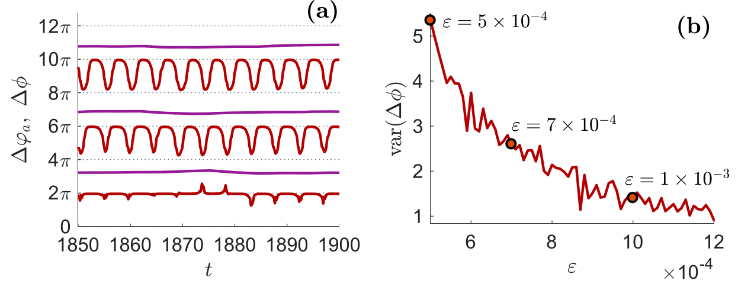
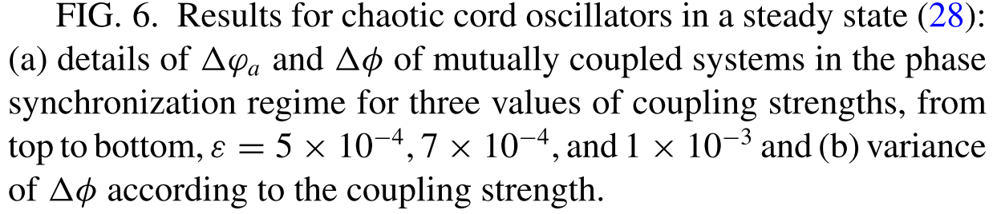
VECTOR FIELD PHASE (VFP) | SYNC QUALITY
Freitas, L., Torres, L. A. B., & Aguirre, L. A. (2018). Phase definition to assess synchronization quality of nonlinear oscillators. Physical Review E, 97(5), 052202.

Slide 8
ASSESMENT TOOLS
VECTOR FIELD PHASE (VFP) | SYNC QUALITY
VARIMAX + MULTIVARIATE SINGULAR SPECTRUM ANALYSIS

Slide 9
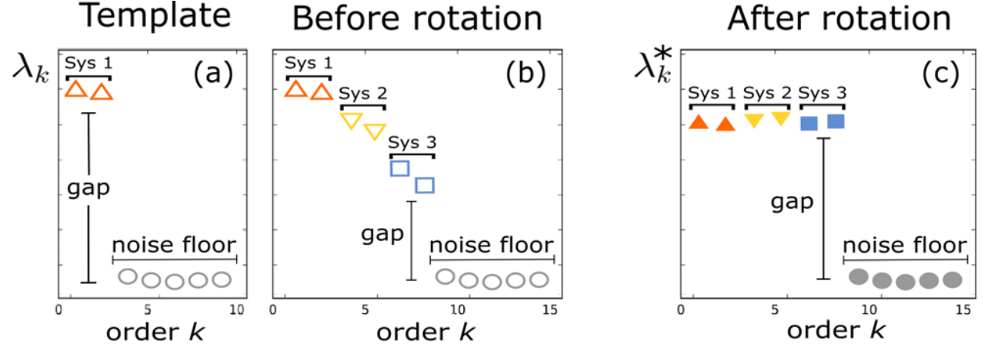
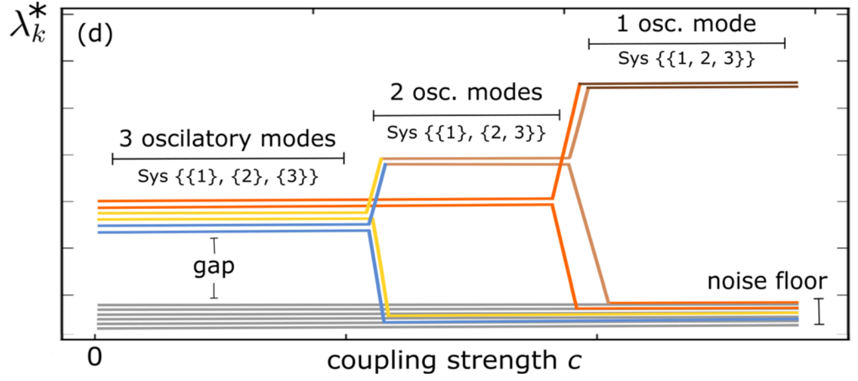
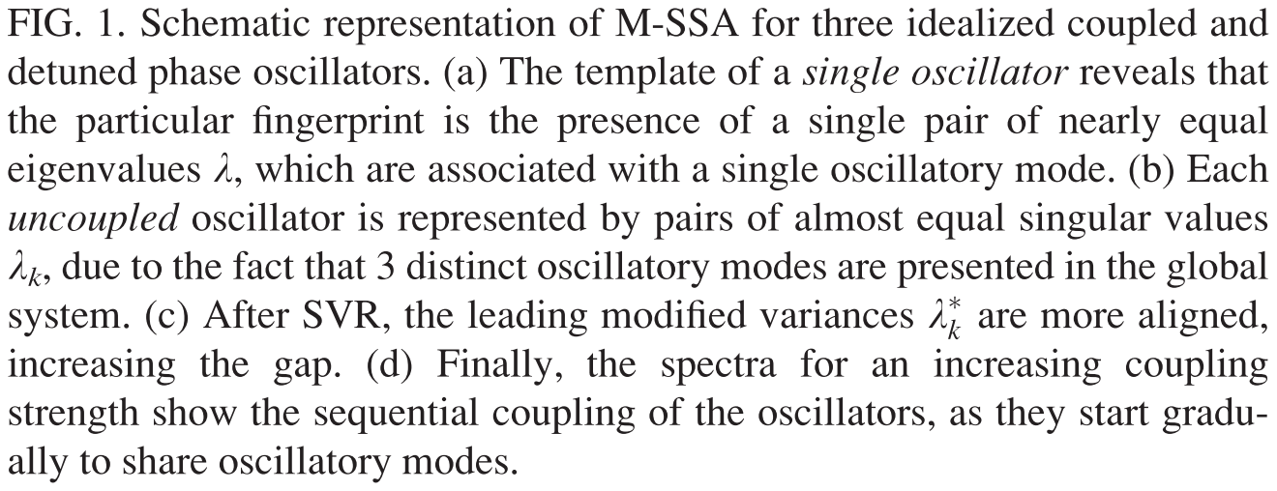
VARIMAX + MULTIVARIATE SINGULAR SPECTRUM ANALYSIS
Portes, L. L., & Aguirre, L. A. (2016). Enhancing multivariate singular spectrum analysis for phase synchronization: The role of observability. Chaos: An Interdisciplinary Journal of Nonlinear Science, 26(9), 093112

Slide 10
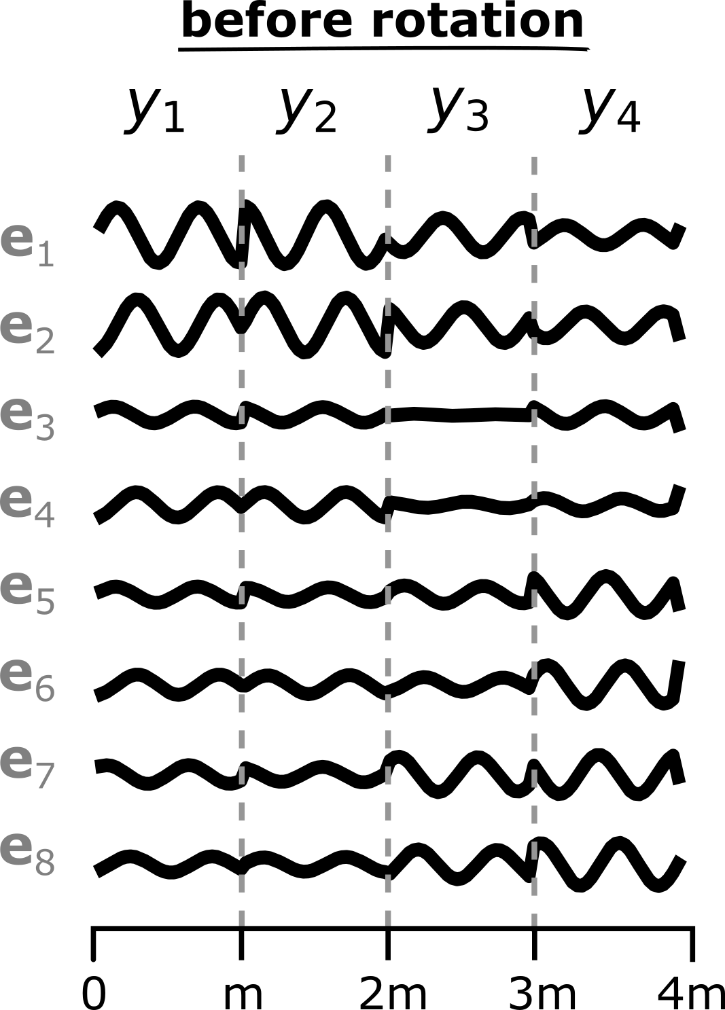
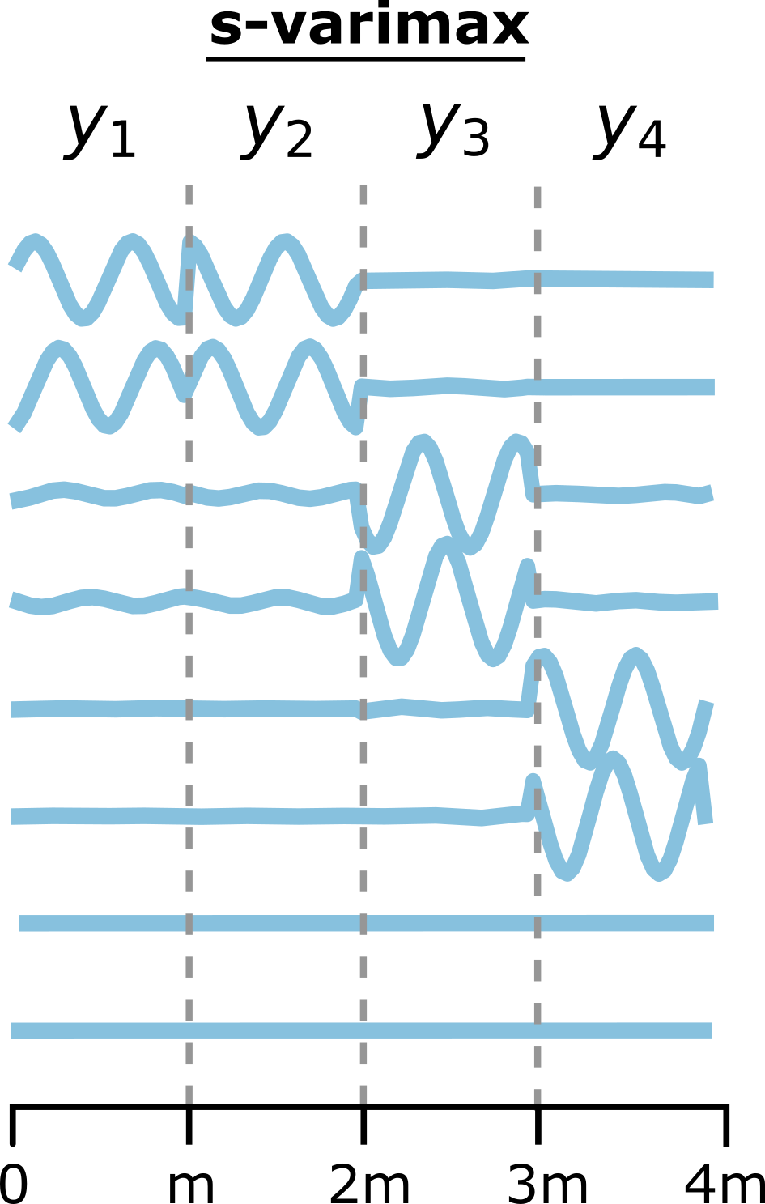
VARIMAX + MULTIVARIATE SINGULAR SPECTRUM ANALYSIS

Slide 11
EXAMPLE
COUPLED ROSSLER OSCILLATORS

Slide 12
If we decrease the coupling strength…
Who will desynchronize first?

Slide 13
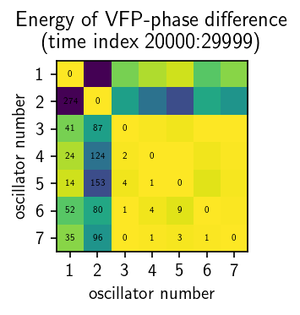
1 and 2 will!

Slide 14
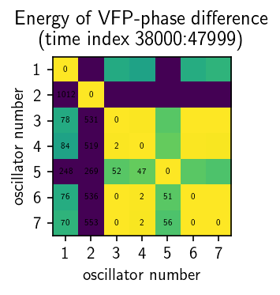
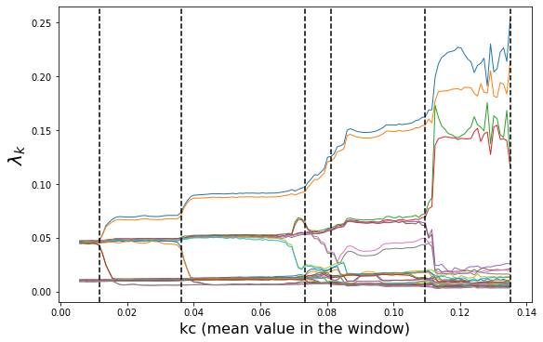
5 will!
1 2 3 4 5 6 7
1 2 3 4 5 6 7

Slide 15
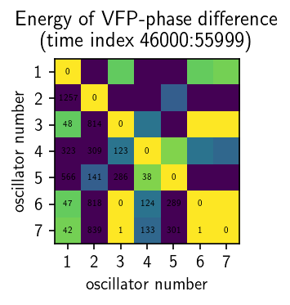
4 will!
1 2 3 4 5 6 7
1 2 3 4 5 6 7
1 2 3 4 5 6 7

Slide 16
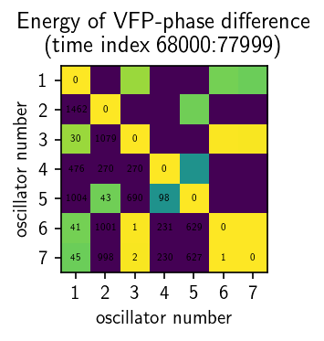
3 (and 4-5) will!
1 2 3 4 5 6 7
1 2 3 4 5 6 7
1 2 3 4 5 6 7
1 2 3 4 5 6 7

Slide 17
1 2 3 4 5 6 7
1 2 3 4 5 6 7
1 2 3 4 5 6 7
1 2 3 4 5 6 7
1 2 3 4 5 6 7

Slide 18
1 2 3 4 5 6 7
1 2 3 4 5 6 7
1 2 3 4 5 6 7
1 2 3 4 5 6 7
1 2 3 4 5 6 7
1 2 3 4 5 6 7

Slide 19
REFERENCES
SYNC QUALITY ASSESMENT
Freitas, L., Torres, L. A. B., & Aguirre, L. A. (2018). Phase definition to assess synchronization quality of nonlinear oscillators. Physical Review E, 97(5), 052202. https://doi.org/10.1103/PhysRevE.97.052202
Aguirre, L. A., & Freitas, L. (2017). Control and observability aspects of phase synchronization. Nonlinear Dynamics, 91(4), 1–15. https://doi.org/10.1007/s11071-017-4009-9
Varimax + MSSA FOR PHASE SYNC CHARACTERIZATION
Groth, A., & Ghil, M. (2011). Multivariate singular spectrum analysis and the road to phase synchronization. Physical Review E, 84(3), 036206. https://doi.org/10.1103/PhysRevE.84.036206
Portes, L. L., & Aguirre, L. A. (2016). Enhancing multivariate singular spectrum analysis for phase synchronization: The role of observability. Chaos: An Interdisciplinary Journal of Nonlinear Science, 26(9), 093112. https://doi.org/10.1063/1.4963013
Portes, L. L., Aguirre, L. A., \bf Portes, L. L., & Aguirre, L. A. (2016). Matrix formulation and singular-value decomposition algorithm for structured varimax rotation in multivariate singular spectrum analysis. Physical Review E, 93(5), 052216. https://doi.org/10.1103/PhysRevE.93.052216
Portes, L. L., & Aguirre, L. A. (2019). Impact of mixed measurements in detecting phase synchronization in networks using multivariate singular spectrum analysis. Nonlinear Dynamics, 96(3), 2197–2209. https://doi.org/10.1007/s11071-019-04917-7
Aguirre, L. A., Portes, L. L., & Letellier, C. (2017). Observability and synchronization of neuron models. Chaos: An Interdisciplinary Journal of Nonlinear Science, 27(10), 103103. https://doi.org/10.1063/1.4985291

Slide 20
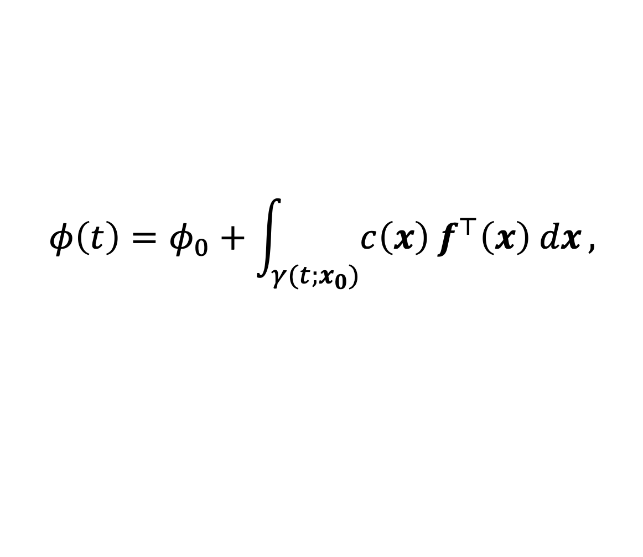

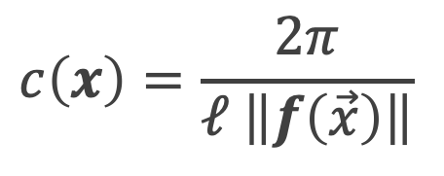
VECTOR FIELD PHASE (VFP) | SYNC QUALITY
For a trajectory $γ(t;x_{0})$ the Vector Field Phase (VFP) is given by:
where $c\left(x\right)$ is a positive function.
$$φ\left(t\right)=φ_{0}+\int_{γ(t;x_{0})}{c\left(x\right) f^{⊤}\left(x\right) dx},$$
$$c\left(x\right)=\frac{2π}{ℓ \left\|f\left(\vec{x}\right)\right\|}$$
Arc length
Freitas, L., Torres, L. A. B., & Aguirre, L. A. (2018). Phase definition to assess synchronization quality of nonlinear oscillators. Physical Review E, 97(5), 052202

Slide 21
VARIMAX + MULTIVARIATE SINGULAR SPECTRUM ANALYSIS
Groth, A., & Ghil, M. (2011). Multivariate singular spectrum analysis and the road to phase synchronization. Physical Review E, 84(3), 036206.
Portes, L. L., & Aguirre, L. A. (2016). Enhancing multivariate singular spectrum analysis for phase synchronization: The role of observability. Chaos: An Interdisciplinary Journal of Nonlinear Science, 26(9), 093112

